Slide 1
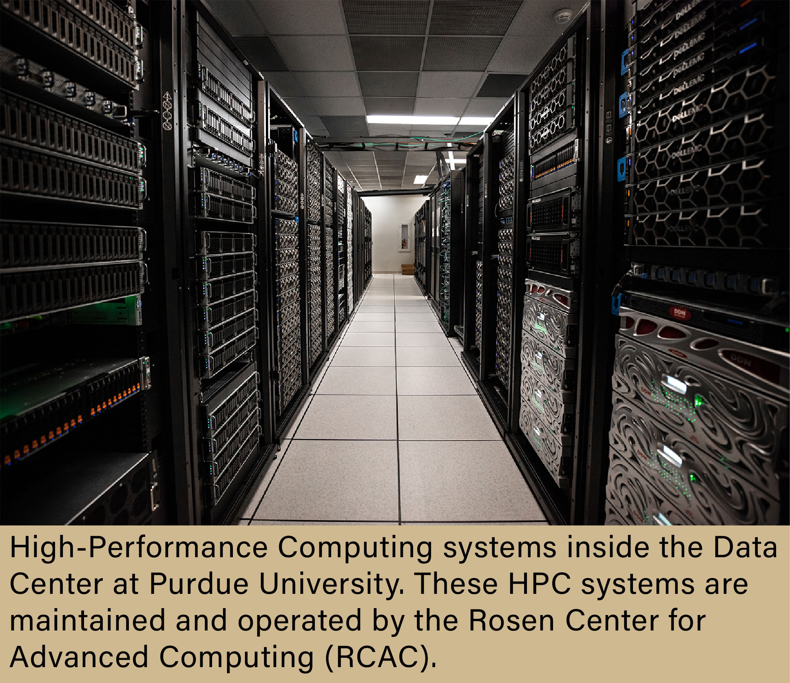
Welcome to RCAC
Accelerating Discovery Through Advanced Computing
Graduate Student Orientation
Who We Are
  Purdue University's research computing organization
  Part of Purdue IT
  Supports research across all colleges and disciplines
Our Mission
  Provide world-class computational resources
  Enable groundbreaking research
  Partner with faculty, staff, and students
Today's Topics
  RCAC services
  Computing resources
  Getting started
  Where to get help
Notes:
Spend ~1 minute on 'Welcome to RCAC'. Personalize with examples from your research group and demonstrate how graduate students can benefit from RCAC.

Slide 2

Who We Are
RCAC supports every college at Purdue.
More Than Just Supercomputers
High-Performance Computing (HPC)
  Large CPU clusters
  GPU clusters for AI and accelerated computing
  National-scale research infrastructure
Research Support
  Individual consultations
  Performance optimization
  Software installation assistance
Training
  Workshops
  Documentation
  Office hours
  Online tutorials
Research Software Engineering
  Scientific application development
  Workflow automation
  Code optimization
Notes:
Spend ~1 minute on 'Who We Are'. Personalize with examples from your research group and demonstrate how graduate students can benefit from RCAC.

Slide 3
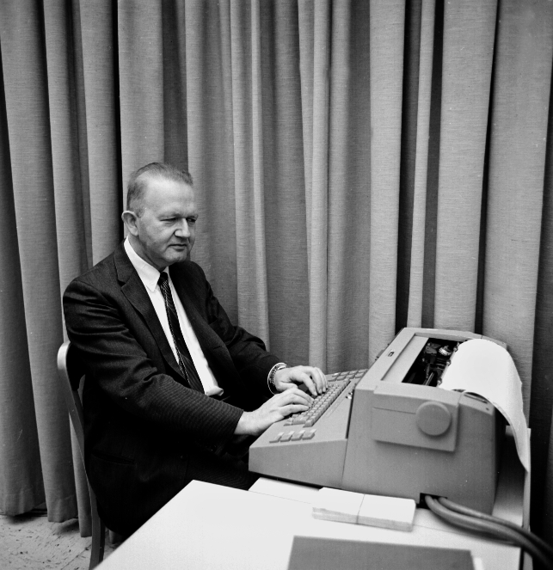
Why HPC?
Desktop and laptop computers have limits.
Run Larger Problems
  Simulations with millions of calculations
  Massive datasets
  Long-running computations
Accelerate Research
  Thousands of processor cores
  High-performance GPUs
  Parallel computing
Common Applications
  Artificial Intelligence
  Computational Biology
  Engineering
  Climate Science
  Data Analytics
Notes:
Spend ~1 minute on 'Why HPC?'. Personalize with examples from your research group and demonstrate how graduate students can benefit from RCAC.

Slide 4
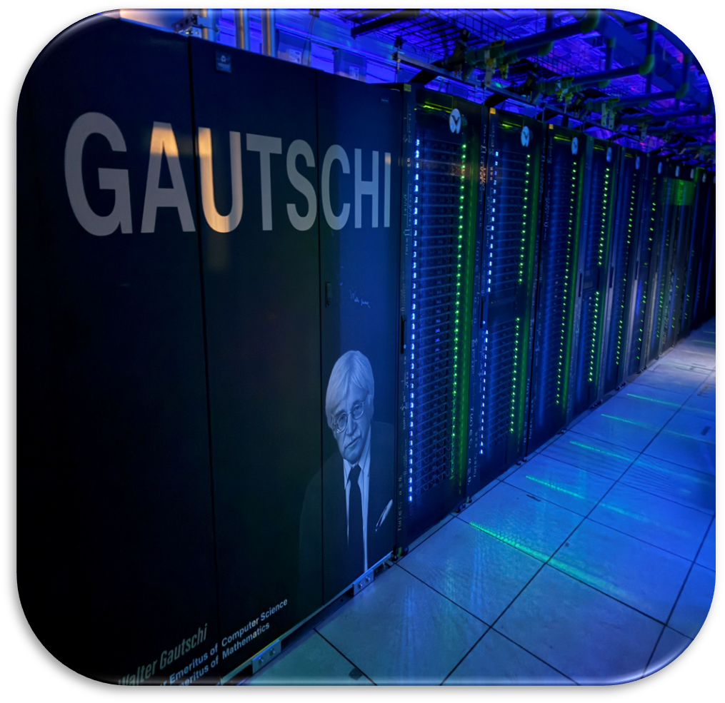
Research Systems
Clusters Available for Use
Computing Resources
Scholar
  Learning Linux and HPC
  Classroom instruction
Research Clusters
  Negishi
  Gilbreth
  Gautschi
National Resource
  Anvil
    NSF ACCESS supercomputer
  Available to researchers nationwide
Common Features
  Linux operating system
  Slurm scheduler
  Thousands of simultaneous users
Notes:
Spend ~1 minute on 'Research Systems'. Personalize with examples from your research group and demonstrate how graduate students can benefit from RCAC.

Slide 5

Research Examples
Used by nearly every discipline.
Examples
Engineering
  Finite Element Analysis
  Computational Fluid Dynamics
  Life Sciences
  Genome assembly
  Protein structure prediction
Artificial Intelligence
  Deep Learning
  Computer Vision
Data Science
  Python
  R
Humanities
  Digital archives
  GIS
Notes:
Spend ~1 minute on 'Research Examples'. Personalize with examples from your research group and demonstrate how graduate students can benefit from RCAC.

Slide 6
How Jobs Run
Typical HPC workflow
How Jobs Run
Connect
  SSH into the cluster
  Authenticate with Purdue credentials
Prepare
  Upload research data
  Load required software modules
Submit
  Create a Slurm job script
  Submit with sbatch
Compute
  Runs on dedicated compute nodes
  Monitor progress with Slurm commands
Retrieve
  Download results
  Analyze data
  Repeat as needed
Notes:
Spend ~1 minute on 'How Jobs Run'. Personalize with examples from your research group and demonstrate how graduate students can benefit from RCAC.

Slide 7

Storage
Research data lifecycle
Suggested Graphic
Insert RCAC or Purdue image,
cluster photo, workflow,
or QR code here.
Managing Your Data
Storage Options
  Home directories
  Project storage
  Scratch storage
  Archive solutions
Best Practices
  Back up important files
  Keep scratch for temporary data
  Organize project directories
Data Transfers
  SCP
  Rsync
  Globus
  High-speed transfers
Notes:
Spend ~1 minute on 'Storage'. Personalize with examples from your research group and demonstrate how graduate students can benefit from RCAC.

Slide 8
Getting Started
First steps
Your First Week
Request Access
  Work with your advisor
  Get permission to be a part of their project
Learn the Basics
  Linux command line
  SSH
  File management
Run Your First Job
  Use Scholar or your assigned cluster
  Submit a simple Slurm job
  Review the output
Continue Learning
  Attend workshops
  Explore documentation
  Meet with RCAC consultants
Notes:
Spend ~1 minute on 'Getting Started'. Personalize with examples from your research group and demonstrate how graduate students can benefit from RCAC.

Slide 9
Support
You're never on your own.
RCAC Support
Consulting
  Research workflow advice
  Software recommendations
  Performance tuning
Technical Support
  Account assistance
  Software installation
  Troubleshooting
Training Resources
  Documentation
  Workshops
  Office hours
National Resources
  ACCESS allocations
  Research collaborations
  Advanced cyberinfrastructure
Notes:
Spend ~1 minute on 'Support'. Personalize with examples from your research group and demonstrate how graduate students can benefit from RCAC.

Slide 10


Questions
Connect with RCAC
Key Takeaways
RCAC Helps You
  Solve larger research problems
  Save time
  Learn new computational skills
Take the Next Step
  Visit rcac.purdue.edu
  Read docs.rcac.purdue.edu
  Talk with your advisor about access
  Attend an RCAC workshop
Questions?
  We look forward to supporting your research journey at Purdue.
Sites
  rcac.purdue.edu
  docs.rcac.purdue.edu
Notes:
Spend ~1 minute on 'Questions'. Personalize with examples from your research group and demonstrate how graduate students can benefit from RCAC.

